Slide 1


COMP7940 Chatbot Project
A Cloud-Native AI Assistant for HKBU Students
PRESENTED BY
Liu Yubin
Chen Yanpeng
Student ID: 25469525
Student ID: 25401947
DATE: April 14, 2026
Notes:
Good morning/afternoon. We are Liu Yubin and Chen Yanpeng. Today, we are excited to present our COMP7940 project: a cloud-native AI assistant for HKBU students, built on Telegram and powered by AWS.

Slide 2





Agenda
What We'll Cover Today
Project Overview
Technical Architecture
01
02
The "Why" behind our chatbot: Understanding the core motivation and goals.
The "How" we built it: Exploring the tech stack and system design workflow.
Core Features
Cloud Deployment
03
The "What" it can do: A detailed showcase of the chatbot's key functionalities.
04
The "Where" it runs: Our strategy for scalable, reliable cloud infrastructure.
05
Key Achievements & Challenges
The "Results" and lessons learned: Measuring the project's success metrics and the obstacles we overcame.
Notes:
Here's the agenda for our presentation. We'll start with an overview of the project, then dive into the technical architecture, showcase the core features, discuss our cloud deployment strategy, and finally, summarize our key achievements and the challenges we overcame.

Slide 3





Project Introduction & Objectives
Robust Cloud Deployment
Persistent Data Storage
Leverage AWS EC2 and Docker to build a stable, scalable, and maintainable backend infrastructure.
Utilize AWS ElastiCache (Redis) to reliably maintain user chat history, preferences, and session states.
The Vision
An AI Campus Assistant
Cost-Effective Solution
Rich Feature Set
PRIMARY GOAL
To develop a Telegram-based AI chatbot tailored specifically for HKBU students, providing academic support and daily utility.
Strategically utilize the AWS Free Tier to achieve zero operational cost while ensuring full functionality.
Integrate a comprehensive suite including AI-powered chat, automated reminders, and practical utility tools.
Notes:
Our project's vision is to create an AI campus assistant for HKBU students. The main goal is to provide a helpful tool for academic support and daily life. To achieve this, we set four core objectives: to build a robust cloud deployment, implement persistent data storage, ensure a cost-effective solution, and develop a rich set of features.

Slide 4




Technical Architecture
A Five-Layer System Design
Our system is built on a modular, layered architecture for maintainability and scalability, ensuring clear separation of concerns across all components.
User Layer
Bot Layer
API Layer
Telegram users interacting via the bot interface, initiating commands and queries.
Core logic in `chatbot.py` handling user intents, session states and interaction flows.
Seamless integration with the HKBU LLM API to generate context-aware intelligent responses.
Data Layer: Persistent Storage
Deployment Layer: Cloud Infrastructure
Utilizes AWS ElastiCache (Redis) for secure, fast, and persistent storage of user conversation history and preferences.
Application containerized with Docker and hosted on an AWS EC2 instance for reliable, scalable production deployment.
Notes:
To ensure maintainability and scalability, we designed a five-layer architecture. It starts with the User Layer, where students interact with the Telegram bot. The Bot Layer processes these interactions. The API Layer connects to the HKBU LLM for AI capabilities. The Data Layer uses Redis for persistent storage. Finally, the Deployment Layer runs everything on an AWS EC2 instance using Docker.

Slide 5




Core Technologies
Powering the Chatbot Infrastructure
AWS EC2
Docker
Redis Cache
Provides at4g.microvirtual server to host the core application securely and efficiently.
Containerizes the app to ensure consistency across development, testing, and production.
In-memory data store for lightning-fast access to user sessions and chat history.
Telegram Bot API
HKBU LLM API
Serves as the front-end user interface, handling message reception, delivery, and inline query interactions.
The "brain" of the chatbot, enabling sophisticated natural language understanding (NLU) and context-aware response generation.
Notes:
Our project is powered by a robust set of technologies. We used AWS EC2 for compute power, Docker for containerization, and AWS ElastiCache with Redis for fast data storage. The Telegram Bot API serves as the user interface, and the HKBU LLM API provides the AI intelligence.

Slide 6
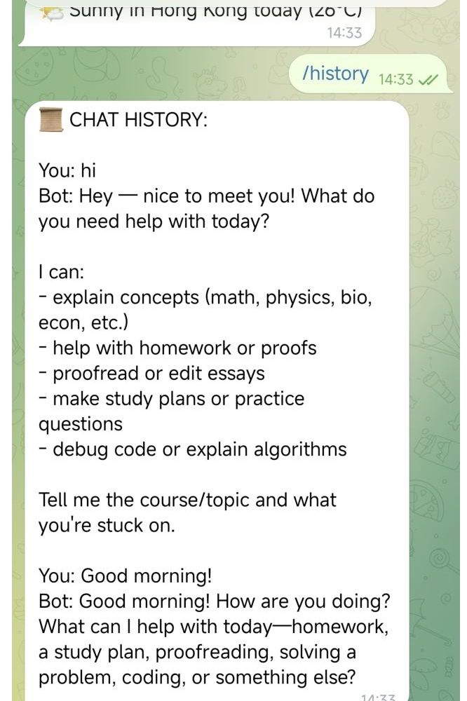


Feature Showcase: AI Chat & History
Intelligent Conversation & Memory
AI Chat: Powered by HKBU LLM
The intelligent bot can assist with homework, explain complex concepts, proofread essays, and debug code efficiently.
Command: `/history`
Users can retrieve and view their entire conversation log with the bot, enabling easy review of past interactions.
Command: `/clear`
Provides users with the ability to clear their chat history at any time, prioritizing user privacy and data control.
Notes:
Now let's look at some features. The core of our bot is its AI chat capability, powered by HKBU's LLM, which can help with various academic tasks. We also implemented a memory feature: users can view their chat history with the `/history` command and clear it with `/clear` for privacy.

Slide 7
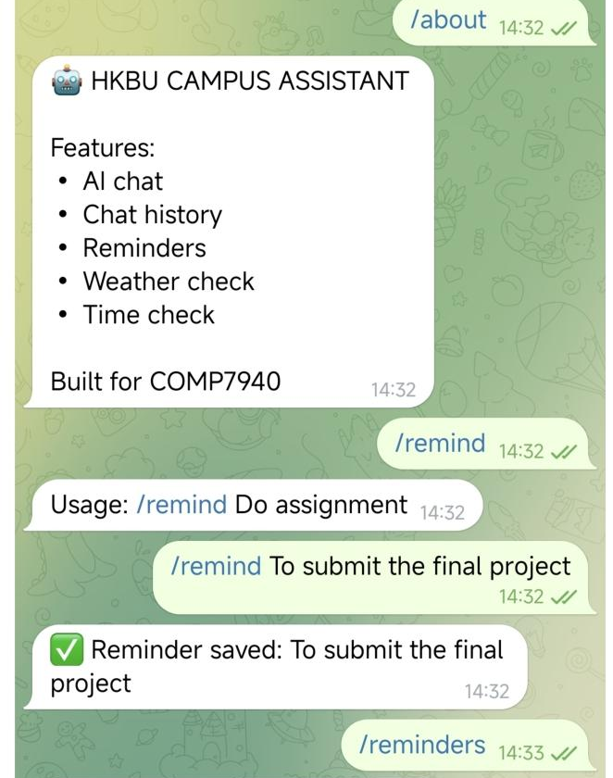



Feature Showcase: Reminders & Utilities
Beyond AI Chat: Practical Tools for Everyday Productivity
⏰ Reminder System
• `/remind [msg]`: Set a quick task reminder (supports natural language). • `/reminders`: Fetch a full list of all currently active & pending reminders.
🌤️ Daily Utilities
• `/weather`: Get the real-time weather forecast for Hong Kong (HK). • `/time`: Instantly check the current local time & full date information.
❓ Help & Guidance
• `/start`: Trigger the initial welcome message & setup introduction. • `/help`: Display a comprehensive reference list of all available commands.
Notes:
Beyond AI chat, we added practical utilities. The reminder system allows users to set and list reminders. We also included commands for checking the weather and time. Of course, standard commands like `/start` and `/help` are also available to guide users.

Slide 8
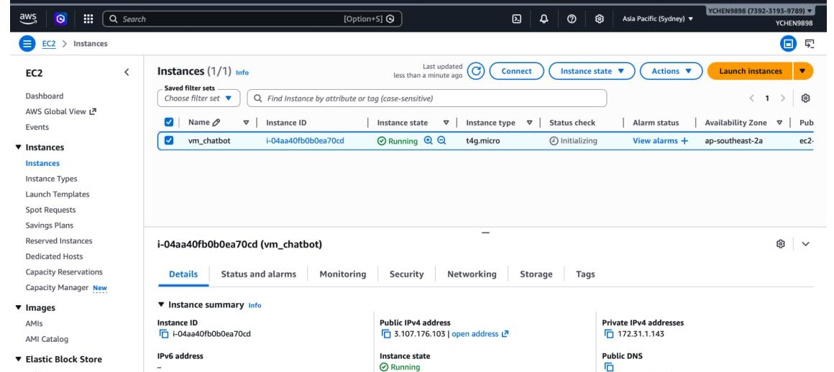


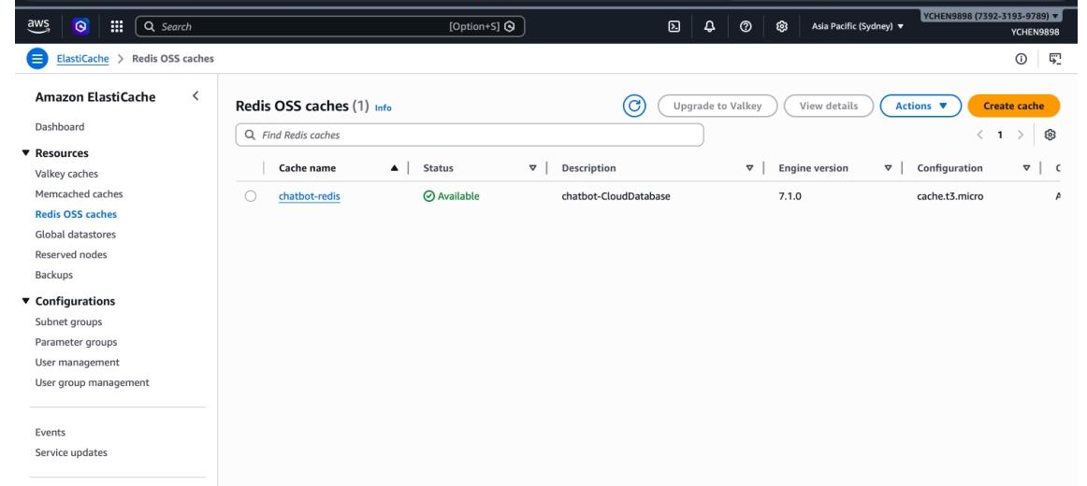

AWS Infrastructure in Action
Proven Cloud Deployment
AWS EC2 Instance
Successfully launched and running an EC2 instance in theap-southeast-2(Sydney) region.
AWS ElastiCache Redis
A dedicated Redis cache cluster is fully set up and securely connected to the primary EC2 instance.
Docker Containerization
The application is containerized for strict isolation, consistent performance, and simplified lifecycle management.
Notes:
Here is our cloud infrastructure in action. We have an EC2 instance running in the Sydney region, and a dedicated ElastiCache Redis cluster connected to it. The entire application is containerized with Docker, ensuring a consistent and manageable deployment.

Slide 9
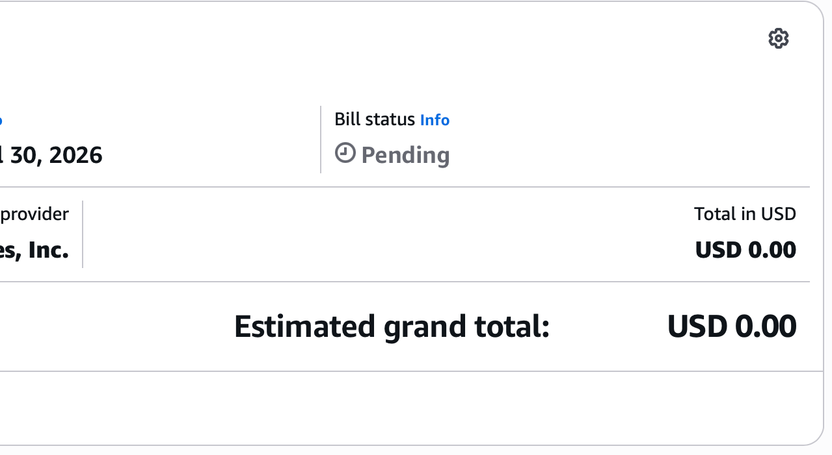


Key Achievement: Zero-Cost Operation
Maximizing the AWS Free Tier
Strategic Resource Selection
Selected services within Free Tier limits, includingt4g.microEC2 instances andcache.t3.microElastiCache to avoid base charges.
Strict Cost Monitoring
Enforced strict IAM permissions and implemented full resource tagging to prevent accidental over-provisioning and unexpected charges.
Proven Cost-Effectiveness
Verified Zero-Cost Deployment
AWS Estimated Bill Summary | April 1 - April 30, 2026
Achieved an estimated monthly cost of$0.00for the entire infrastructure.
Notes:
One of our key achievements is achieving zero-cost operation. By strategically selecting AWS resources that fall within the Free Tier and implementing strict cost monitoring, we have successfully kept the estimated monthly charges at $0.00. This demonstrates a highly cost-effective deployment strategy, which is crucial for student projects.

Slide 10


Key Challenges & Solutions
Overcoming Hurdles in Development
Docker Startup Failure
Redis Connectivity Issues
API Rate Limits
THE ISSUE
THE ISSUE
THE ISSUE
Persistent crashes due to incorrect file permissions and missing critical environment variables.
Connection refused errors caused by strict VPC isolation and blocked security group inbound rules.
Risk of hitting LLM API rate limits, leading to service throttling and degraded user experience.
THE SOLUTION
THE SOLUTION
THE SOLUTION
Fixed `config.ini` permissions to 644 and properly set all required env vars in the compose file.
Configured VPC peering between services and added explicit inbound rules for Redis port 6379.
Implemented a robust request caching layer using Redis to minimize redundant API calls.
Notes:
During development, we faced several challenges. We resolved Docker startup failures by fixing permissions and environment variables. We overcame Redis connectivity issues by adjusting VPC and security group settings. And to handle potential API rate limits, we implemented a caching mechanism using Redis.

Slide 11



Project Summary & Achievements
A Successful Delivery
Fully Functional Bot
Robust Cloud Deployment
Delivered a multi-feature AI chatbot with 9 core commands for seamless user interaction.
Successfully deployed a fully containerized application on AWS EC2 for high availability.
Secure & Persistent Storage
Cost-Effective Operation
Implemented AWS ElastiCache (Redis) for reliable, low-latency and persistent data management.
Achieved the goal of zero-cost operation by leveraging the AWS Free Tier resources efficiently.
Notes:
To summarize, we successfully delivered a fully functional AI chatbot with 9 core commands. We deployed it robustly on AWS EC2 using Docker, implemented secure and persistent storage with Redis, and achieved our goal of zero-cost operation.

Slide 12
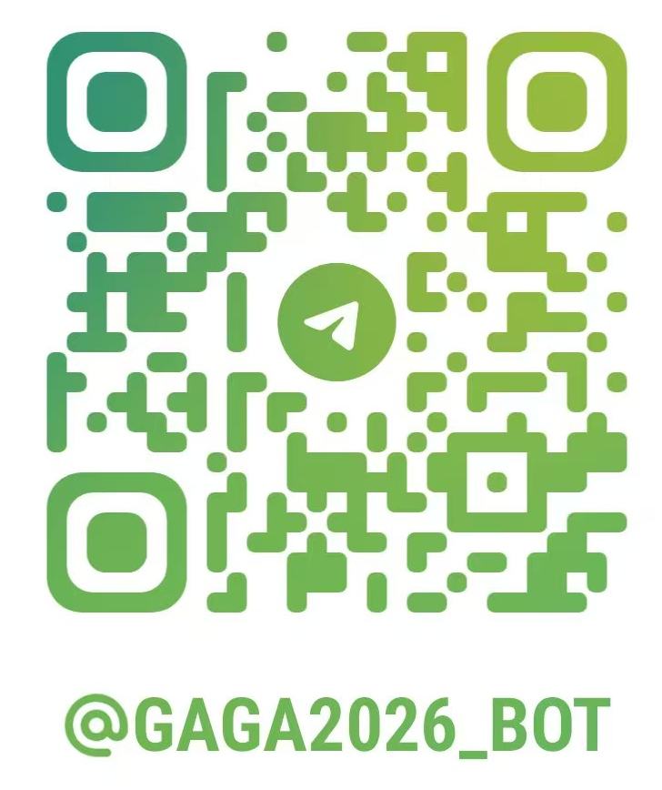


Thank You!
Any Questions?
GitHub Repository
github.com/EvanCHEN9898/comp7940-chatbot
Try the Bot on Telegram
t.me/Gaga2026_bot
COMP7940 Cloud-Native AI Chatbot Project Presentation
Notes:
Thank you for your attention. We have demonstrated our cloud-native AI chatbot project. The source code is available on GitHub, and you are welcome to try the bot using the QR code or the link provided. We are now happy to answer any questions you may have.

